Slide 1
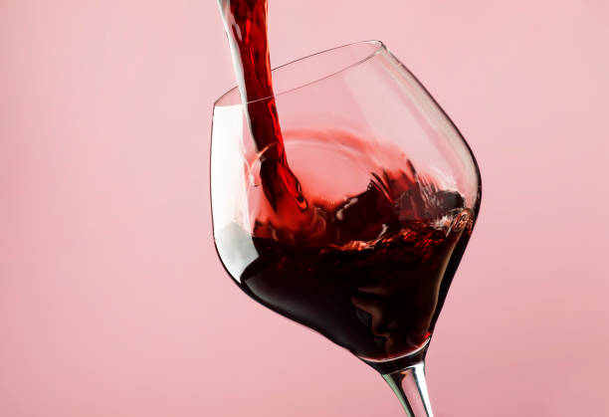
Wine Quality Analysis
Pattapu Teja Sri(J2)
Siri Sudheeksha(K1)
Surya Kiran(K1)

Slide 2
CONTENTS
Problem Statement
Objective
Abstract
Justification
Algorithms used

Slide 3
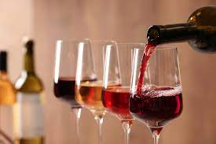
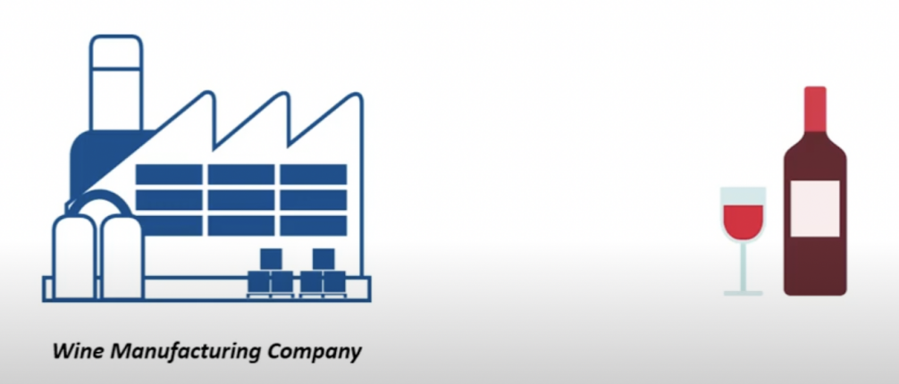
PROBLEM STATEMENT
Consider a wine manufacturing company and this company wants to create a new brand of wine.Here we are finding the quality of the wine using several chemical parametres like acidity, citric acid content etc. and now we are going to build a machine learning model that takes in all these chemical parameters to determine whether the wine is of good quality or not and determine what is its quality.

Slide 4
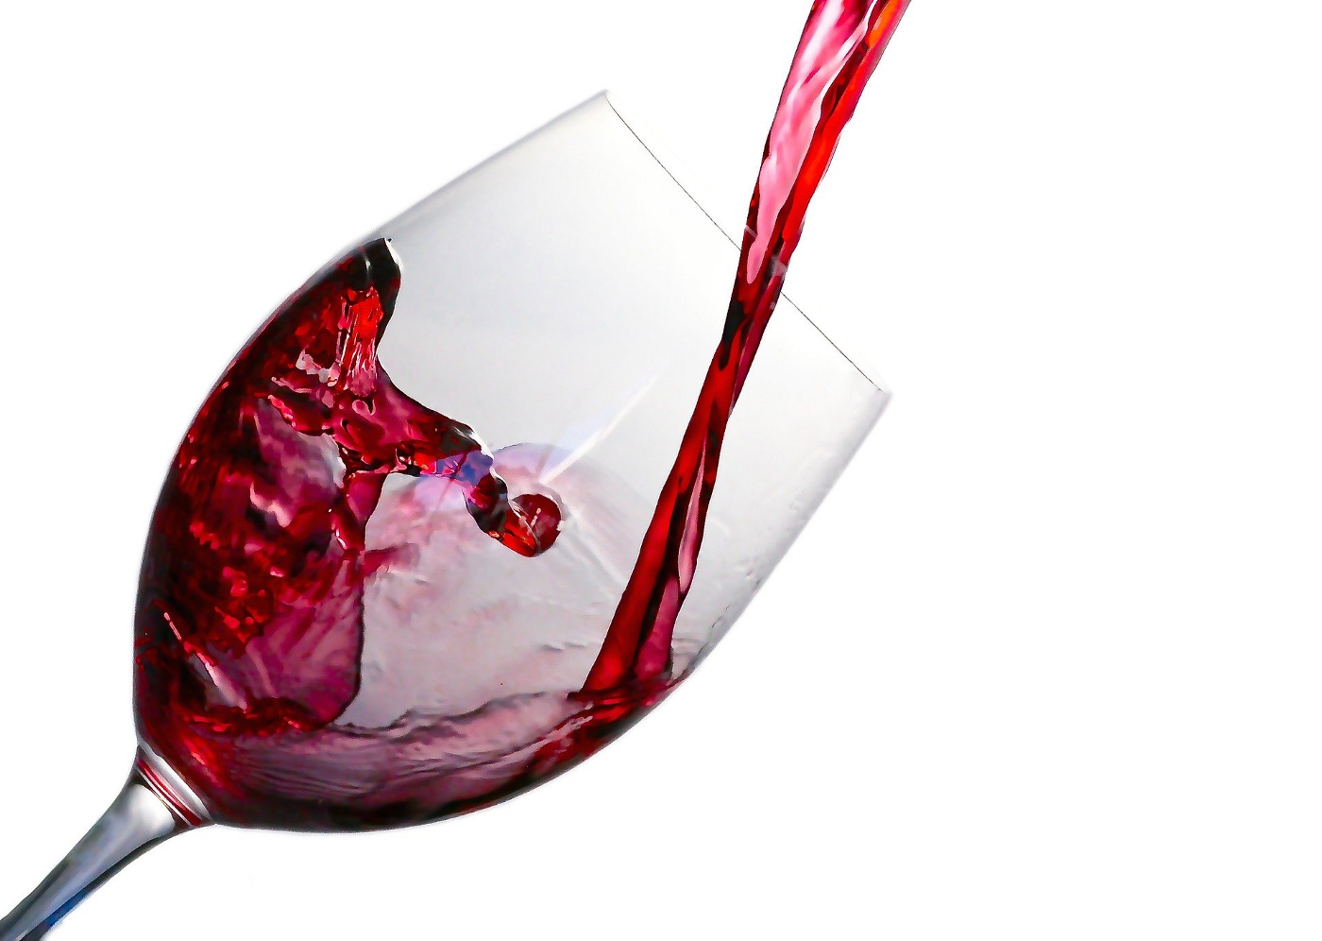
Objective
The objectives of this project are as follows:
1)To experiment with different classification methods to see which yields the highest accuracy
2)To determine which features are the most indicative of a good quality wine

Slide 5
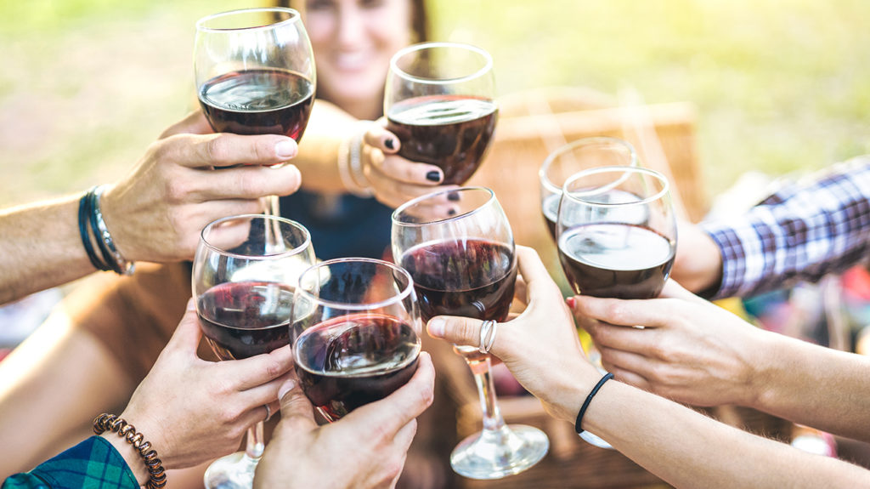
Abstract
These days the consumption of red wine is very common to all. So many mine manufacturing companies are being set. So it became important to analyze the quality of red wine before its consumption to preserve human health. Hence this research is a step towards the quality prediction of the red wine using its various attributes. Dataset is taken from the sources and the techniques such as Random Forest, Logistic Regression, SVM(rbf) and SVM(linear) are applied. Various measures are calculated and the results are compared among training set and testing set and accordingly the best out of the two techniques depending on the training set results is predicted. Better results can be observed if the best features out from other techniques are extracted and merged with one another to improve the accuracy and efficiency.

Slide 6
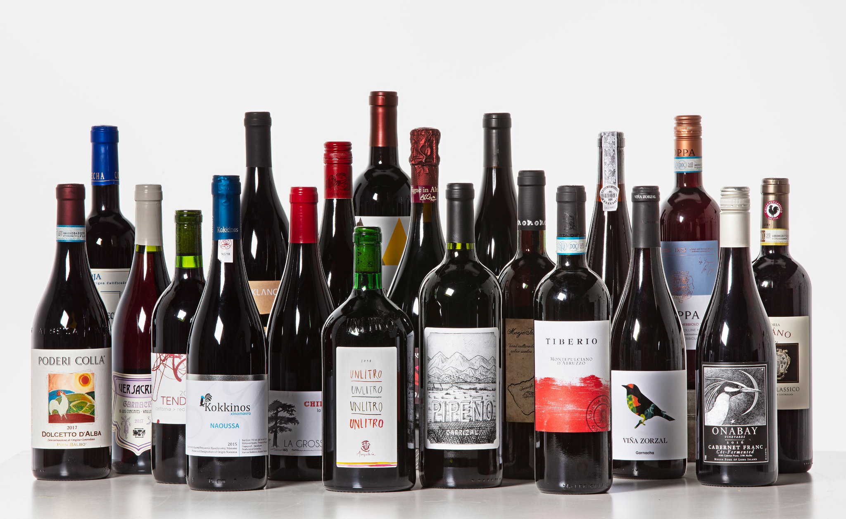
Algorithms used
1) Logistic Regression
2)SVM(rbf)
3)SVM(Linear)
4)Random Forest Classifier

Slide 7
Justification
By looking into the details, we can see that good quality wines have higher levels of alcohol on average, have a lower volatile acidity on average, higher levels of sulphates on average, and higher levels of residual sugar on average.

Slide 8
THANK-YOU

